Slide 1

Learning Objectives
LO1 Record a deposit on a check stub.
LO2 Endorse checks using blank, special, and restrictive endorsements.
LO3 Prepare a check stub and a check.
© 2014 Cengage Learning. All Rights Reserved.

Slide 2
How Businesses Use Cash
Lesson 5-1
LO1
Small cash payments
Issues related to cash
Chance of recording errors
Ease of transfer without any question about ownership
Loss as cash is moved from one place to another
Safety measures

Slide 3
Checking Account
Lesson 5-1
LO1
A business form ordering a bank to pay cash from a bank account is known as a check.
A bank account from which payments can be ordered by a depositor is called a checking account.
Opening a checking account
Signature card
Deposit slip

Slide 4
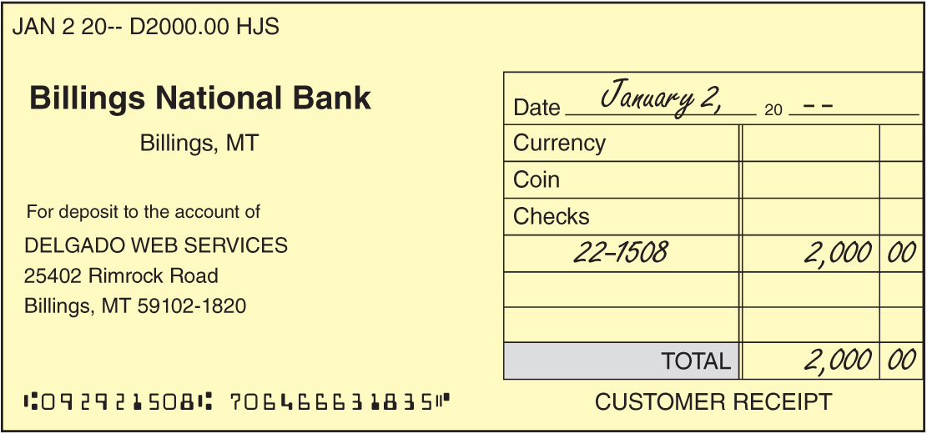
Depositing Cash
Lesson 5-1
LO1
A bank form which lists the checks, currency, and coins an account holder is adding to the bank account is called a deposit slip.

Slide 5
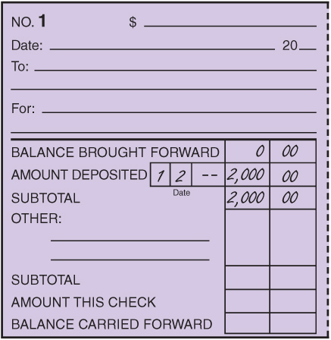
Deposit Recorded on a Check Stub
Lesson 5-1
LO1
1. Write balance brought forward on the check stub.
1
2. Write the date of the deposit on the stub.
3. Write the amount of the deposit on the stub.
4. Calculate the subtotal.
4
2
3

Slide 6
Endorsement
Lesson 5-1
LO2
A signature or stamp on the back of a check transferring ownership is called an endorsement.
Three types of commonly used endorsements
Blank endorsement
Special endorsement
Restrictive endorsement

Slide 7
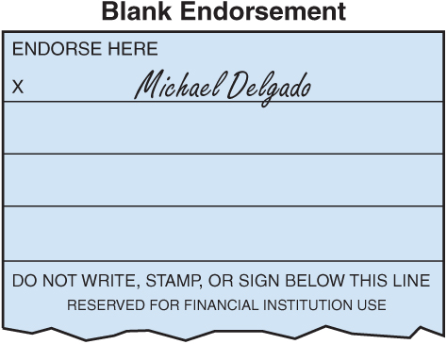
Blank Endorsement
Lesson 5-1
LO2
An endorsement consisting only of the endorser’s signature is called a blank endorsement.

Slide 8
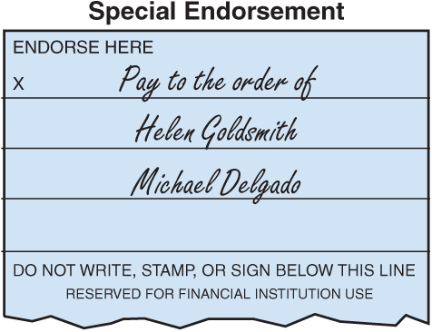
Special Endorsement
Lesson 5-1
LO2
An endorsement indicating a new owner of a check is called a special endorsement.
A special endorsement is sometimes known as an endorsement in full.

Slide 9
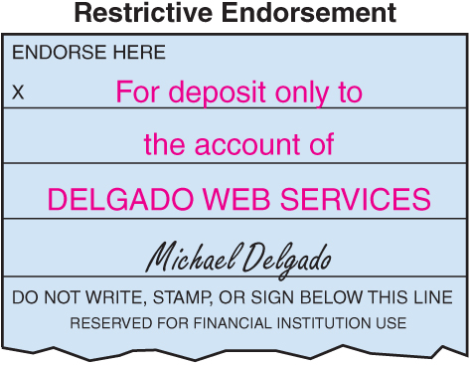
Restrictive Endorsement
Lesson 5-1
LO2
An endorsement restricting further transfer of a check’s ownership is called a restrictive endorsement.

Slide 10
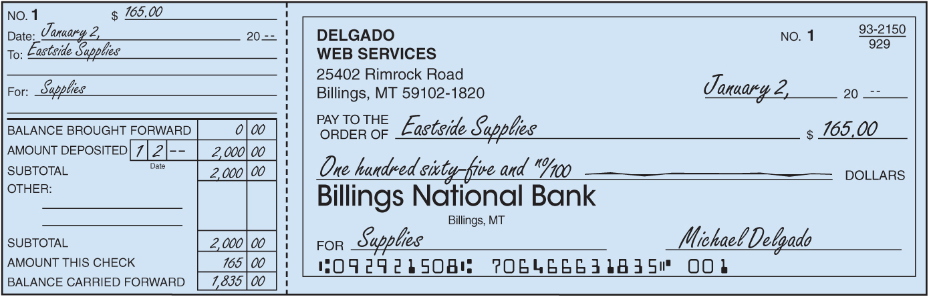
Completed Check Stub and Check
Lesson 5-1
LO3
1
2
3
4
5
6
1. Write the amount of the check on the stub.
2. Write the date of the check on the stub.
3. Write to whom the check is to be paid on the stub.
4. Record the purpose of the check on the stub.
5. Write the amount of the check on the stub.
6. Calculate the new checking account balance and record the new balance.

Slide 11
Completed Check Stub and Check
Lesson 5-1
LO3
7
8
9
10
11
12
7. Write the date the check is issued.
8. Write to whom the check is to be paid.
9. Write the amount in figures.
10. Write the amount in words.
11. Write the purpose of the check.
12. Sign the check.

Slide 12
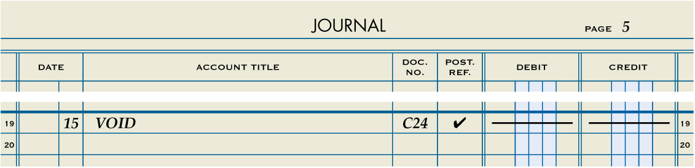
Recording a Voided Check
Lesson 5-1
LO3
1
2
3
4
5
1. Record the date in the Date column.
2. Write the word VOID in the Account Title column.
3. Write the check number in the Doc. No. column.
4. Place a check mark in the Post. Ref. column.
5. Place a dash in both the Debit and Credit columns.

Slide 13

Lesson 5-1 Audit Your Understanding
Lesson 5-1
1. List the three types of endorsements.
ANSWER
Blank endorsement
Special endorsement
Restrictive endorsement

Slide 14
Lesson 5-1 Audit Your Understanding
Lesson 5-1
2. List the steps for preparing a check stub.
ANSWER
1. Write the amount of the check after the dollar sign at the top of the stub.
2. Write the date of the check on the Date line.
3. Write to whom the check is to be paid on the To line.
4. Record the purpose of the check on the For line.
5. Write the amount of the check after the words Amt. This Check.
6. Calculate the new checking account balance and record it in the amount column on the last line of the stub.

Slide 15
Lesson 5-1 Audit Your Understanding
Lesson 5-1
3. List the steps for preparing a check.
ANSWER
1. Write the date.
2. Write to whom the check is to be paid following the words Pay to the order of.
3. Write the amount in figures following the dollar sign.
4. Write the amount in words and draw a line through the unused space up to the word Dollars.
5. Write the purpose of the check on the line labeled For.
6. Sign the check.

Slide 16
work together 5-1 on your own 5-1
Get a copy of the Lesson 5-1 worksheet
Handouts Provided / Print
work together will be started in class
Complete on your own
Turn in when both assignments completed

Slide 17

Learning Objectives
LO4 Complete a bank statement reconciliation.
LO5 Record and journalize a bank service charge.
© 2014 Cengage Learning. All Rights Reserved.

Slide 18
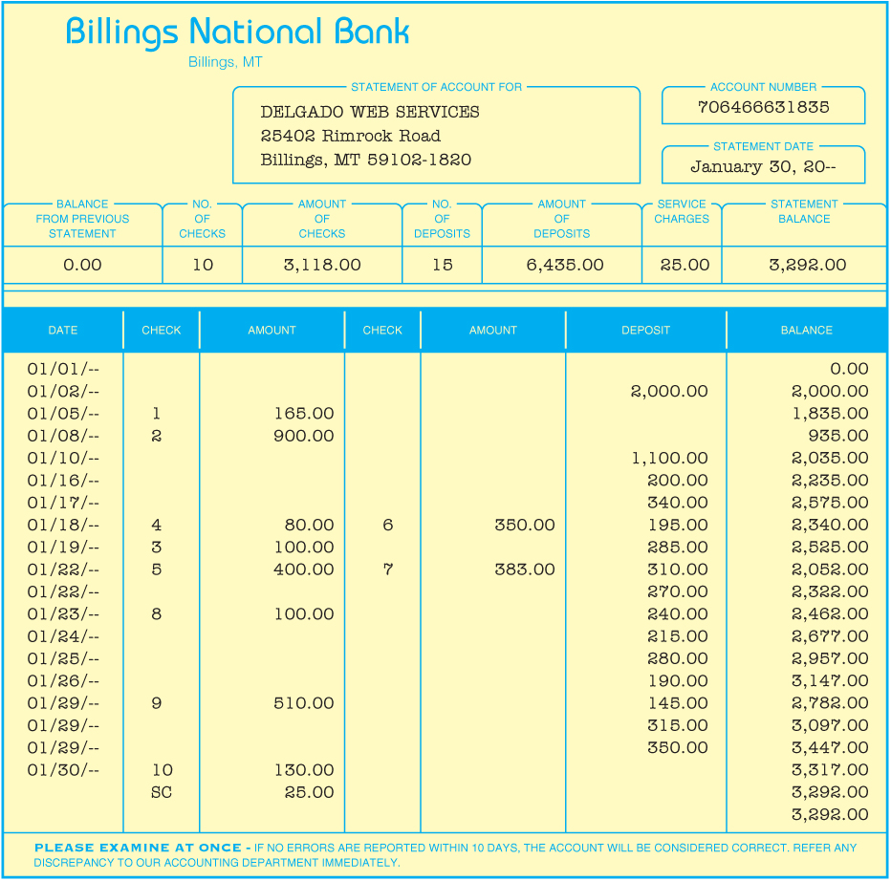
Bank Statement
Lesson 5-2
LO4
A report of deposits, withdrawals, and bank balances sent to a depositor by a bank is called a bank statement.
A check which has been paid by the bank is called a canceled check.

Slide 19
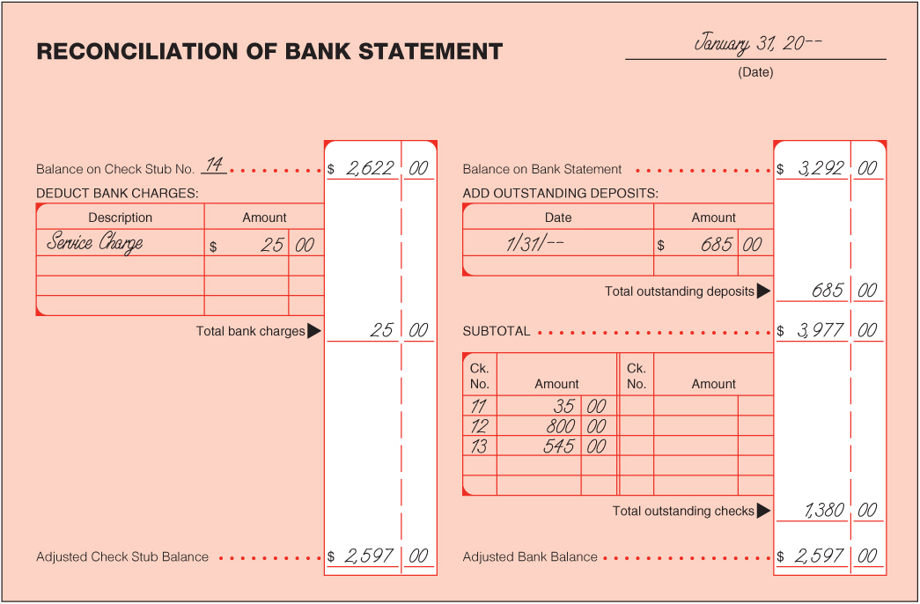
Bank Statement Reconciliation
Lesson 5-2
LO4
2
Check Stub Balance
1
Date
Bank Statement Balance
5
Service Charge
3
6
Outstanding Deposits
7
Subtotal
8
Outstanding Checks
9
Adjusted Bank Balance
4
Adjusted Check Stub Balance
10
Compare Adjusted Balances

Slide 20
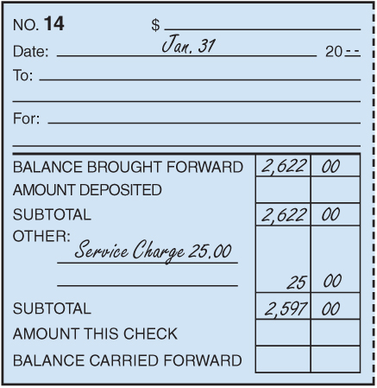
Recording a Bank Service Charge on a Check Stub
Lesson 5-2
LO5
2
3
1
1. Write Service Charge on the check stub under the heading Other.
2. Write the amount of the service charge in the amount column.
3. Calculate and record the new subtotal on the Subtotal line.

Slide 21
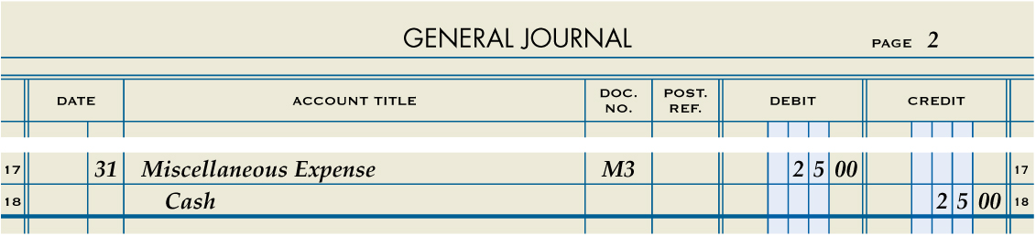
Journalizing a Bank Service Charge
Lesson 5-2
LO5
January 31. Received bank statement showing January bank service charge, $25.00. Memorandum No. 3.
Miscellaneous Expense
25.00
Cash
1
Date
2
Debit
4
Source Document
25.00
3
Credit
1. Write the date in the Date column.
2. Write the title of the account to be debited in the Account Title column. Record the amount debited in the Debit column.
3. On the next line, indented, write the title of the amount credited in the Account Title column. Write the credit amount in the Credit column.
4. Write the source document number in the Doc. No. column.

Slide 22
Lesson 5-2 Audit Your Understanding
Lesson 5-2
1. List four reasons why a depositor’s records and a bank’s records may differ.
ANSWER
1. A service charge may not have been recorded in the depositor’s business records.
2. Outstanding deposits may be recorded in the depositor’s records but not on a bank statement.
3. Outstanding checks may be recorded in the depositor’s records but not on a bank statement.
4. A depositor may have made a math or recording error.

Slide 23
Lesson 5-2 Audit Your Understanding
Lesson 5-2
2. If a check mark is placed on the check stub of each canceled check, what does a check stub with no check mark indicate?
ANSWER
An outstanding check

Slide 24
work together 5-2 on your own 5-2
Open work-own 5-2
work together will be started in class
Complete on your own
Submit when finished

Slide 25
Application Problems
Complete the following Application Problems
P5-1
Worksheet/Submit
P5-2
Self-Correcting Excel File

Slide 26

Learning Objectives
LO6 Complete recordkeeping for a dishonored check.
LO7 Journalize an electronic funds transfer.
LO8 Journalize a debit card transaction.
© 2014 Cengage Learning. All Rights Reserved.

Slide 27
Recording a Dishonored Check on a Check Stub
Lesson 5-3
LO6
A check that a bank refuses to pay is called a dishonored check.
A check dishonored by the bank because of insufficient funds in the account of the maker of the check is called a non-sufficient funds check.
A non-sufficient funds check is also known as an NSF check.

Slide 28
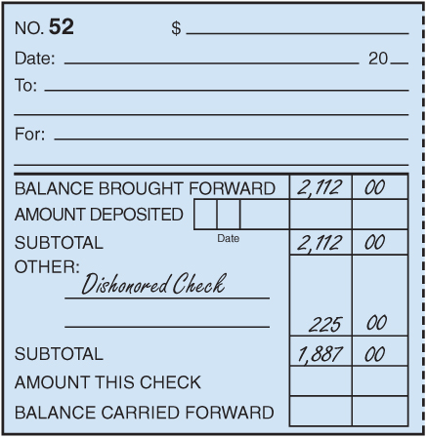
Recording a Dishonored Check on a Check Stub
Lesson 5-3
LO6
2
1
3
1. Write Dishonored Check under the heading Other.
2. Write the total of the dishonored check in the amount column. This is the amount of the dishonored check plus the service fee.
3. Calculate and record the new subtotal.

Slide 29
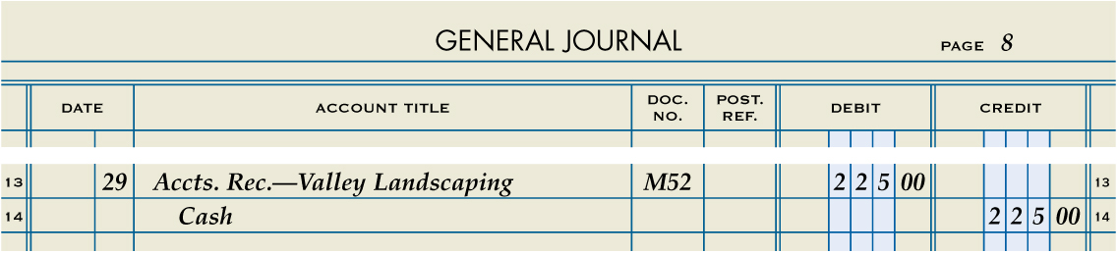
Journalizing a Dishonored Check
Lesson 5-3
LO6
August 29. Received notice from the bank of a dishonored check from Valley Landscaping, $185.00, plus $40.00 fee; total, $225.00. Memorandum No. 52.
Accts. Rec.—Valley Landscaping
225.00
Cash
225.00
1
Date
2
Debit
4
Source Document
3
Credit
1. Write the date in the Date column.
2. Write the title of the account to be debited in the Account Title column. Record the amount debited in the Debit column.
3. On the next line, indented, write the title of the amount credited in the Account Title column. Write the credit amount in the Credit column.
4. Write the source document number in the Doc. No. column.

Slide 30
Journalizing an Electronic Funds Transfer
Lesson 5-3
LO7
A computerized cash payments system that transfers funds without the use of checks, currency, or other paper documents is called electronic funds transfer (EFT).

Slide 31
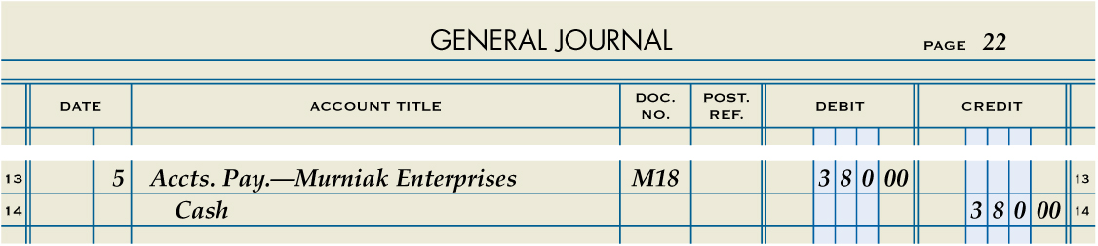
Journalizing an Electronic Funds Transfer
Lesson 5-3
LO7
June 5. Paid cash on account to Murniak Enterprises, $380.00, using EFT. Memorandum No. 18.
Accts. Pay.—Murniak Enterprises
380.00
Cash
380.00
1
Date
2
Debit
4
Source Document
3
Credit
1. Write the date in the Date column.
2. Write the title of the account to be debited in the Account Title column. Record the amount debited in the Debit column.
3. On the next line, indented, write the title of the amount credited in the Account Title column. Write the credit amount in the Credit column.
4. Write the source document number in the Doc. No. column.

Slide 32
Journalizing a Debit Card Transaction
Lesson 5-3
LO8
A bank card that automatically deducts the amount of a purchase from the checking account of the cardholder is called a debit card.

Slide 33
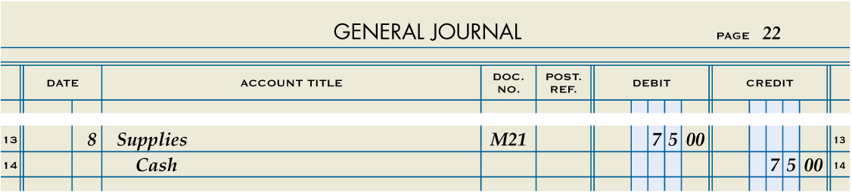
Journalizing a Debit Card Transaction
Lesson 5-3
LO8
Supplies
June 8. Purchased supplies, $75.00, using debit card. Memorandum No. 21.
75.00
Cash
75.00
1
Date
2
Debit
4
Source Document
3
Credit
1. Write the date in the Date column.
2. Write the title of the account to be debited in the Account Title column. Record the amount debited in the Debit column.
3. On the next line, indented, write the title of the amount credited in the Account Title column. Write the credit amount in the Credit column.
4. Write the source document number in the Doc. No. column.

Slide 34
Lesson 5-3 Audit Your Understanding
Lesson 5-3
1. List six reasons why a bank may dishonor a check.
ANSWER
1. The check appears to be altered.
2. The signature on the check does not match the signature on the signature card.
3. The amounts written in figures and in words do not agree.
4. The check is postdated.
5. The person who wrote the check has stopped payment on it.
6. The account of the person who wrote the check has insufficient funds to pay the check.

Slide 35
Lesson 5-3 Audit Your Understanding
Lesson 5-3
2. Which account is credited when electronic funds transfer is used to pay cash on account?
ANSWER
Cash

Slide 36
Lesson 5-3 Audit Your Understanding
Lesson 5-3
3. Which account is credited when a debit card is used to purchase supplies?
ANSWER
Cash

Slide 37
work together 5-3 on your own 5-3
Open work-own 5-3
work together will be started in class
Complete on your own
Print and turn in when finished.

Slide 38

Learning Objectives
LO9 Establish a petty cash fund.
LO10 Prepare a petty cash report.
LO11 Replenish a petty cash fund.
© 2014 Cengage Learning. All Rights Reserved.

Slide 39
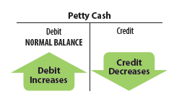
Establishing a Petty Cash Fund
Lesson 5-4
LO9
An amount of cash kept on hand and used for making small payments is called petty cash.

Slide 40
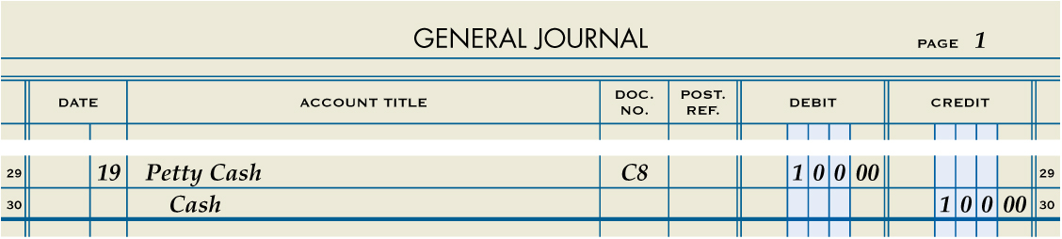
Establishing a Petty Cash Fund
Lesson 5-4
LO9
Petty Cash
January 19. Paid cash to establish a petty cash fund, $100.00. Check No. 8.
100.00
Cash
100.00
1
Date
2
Debit
4
Source Document
3
Credit
1. Write the date in the Date column.
2. Write the title of the account to be debited in the Account Title column. Record the amount debited in the Debit column.
3. On the next line, indented, write the title of the amount credited in the Account Title column. Write the credit amount in the Credit column.
4. Write the source document number in the Doc. No. column.

Slide 41
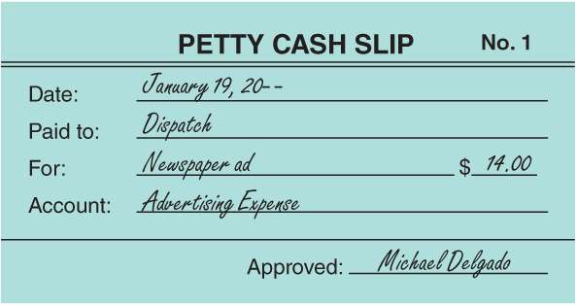
Making Payments from a Petty Cash Fund with a Petty Cash Slip
Lesson 5-4
LO9
A form showing proof of a petty cash payment is called a petty cash slip.

Slide 42
Petty Cash Report
Lesson 5-4
LO10
A petty cash on hand amount that is less than a recorded amount is called cash short.
A petty cash on hand amount that is more than a recorded amount is called cash over.
The custodian prepares a petty cash report when the petty cash fund is to be replenished.

Slide 43
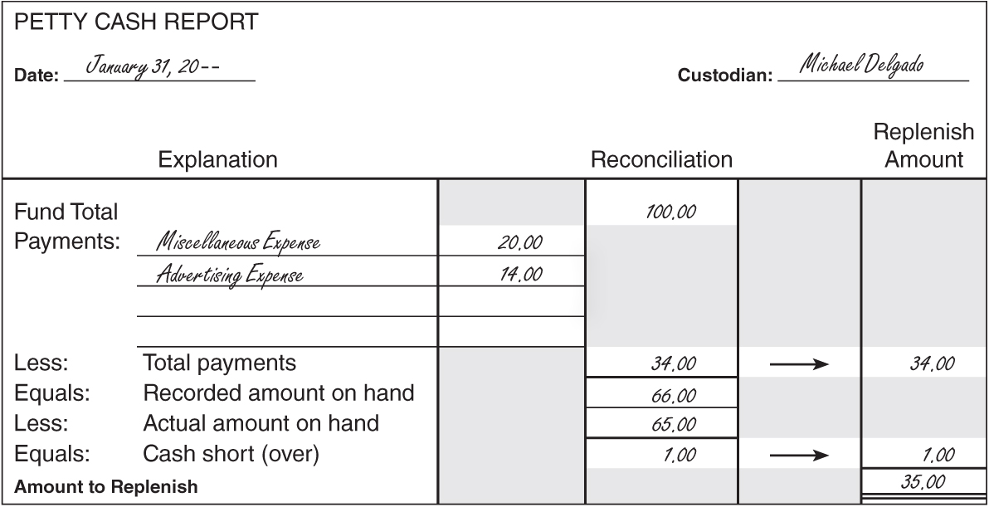

Petty Cash Report
Lesson 5-4
LO10
1
Date and Custodian Name
2
Fund Total
Payments by General Ledger Account
3
4
Total Payments
8
Amount to
Replenish
Recorded Amount on Hand
5
7
Subtract the actual cash on hand from the recorded amount on hand.
6
Actual Cash on Hand

Slide 44
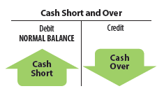
Replenishing Petty Cash
Lesson 5-4
LO11
Account title—Cash Short and Over
Debited when cash is short
Credited when cash is over
Account balance
Either a debit or credit
Usually a debit
Petty cash fund more likely to be short than over

Slide 45

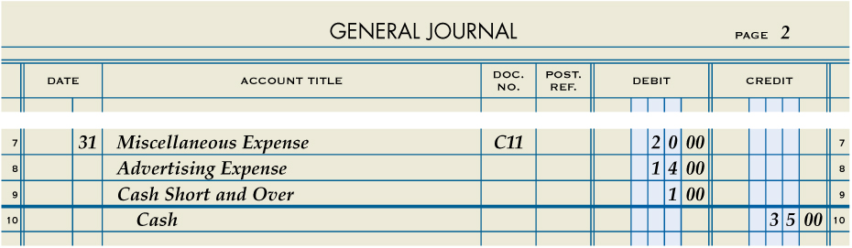
Replenishing Petty Cash
Lesson 5-4
LO11
January 31. Paid cash to replenish the petty cash fund, $35.00: Miscellaneous Expense, $20.00; Advertising, $14.00, Cash Short and Over, $1.00. Check No. 11.
Miscellaneous Expense
20.00
Advertising Expense
14.00
Cash Short and Over
1.00
Cash
35.00
Date
Debits
Credit
Cash Short (a Debit) or Cash Over (a Credit)
1
2
4
3
5
Source Document

Slide 46
Lesson 5-4 Audit Your Understanding
Lesson 5-4
1. Why do businesses use petty cash funds?
ANSWER
For making small cash payments for which writing a check is not time- or cost-effective

Slide 47
Lesson 5-4 Audit Your Understanding
Lesson 5-4
2. Why is Cash rather than Petty Cash credited when a petty cash fund is replenished?
ANSWER
The check issued to replenish petty cash is a credit to Cash and does not affect Petty Cash.

Slide 48
work together 5-4 on your own 5-4
Open work-own 5-4
work together will be started in class
Complete on your own
Submit when finished

Slide 49
Application Problems
Complete the following Application Problems
5-3
Self Correcting Excel Problem
5-4
Excel Problem

